Slide 1
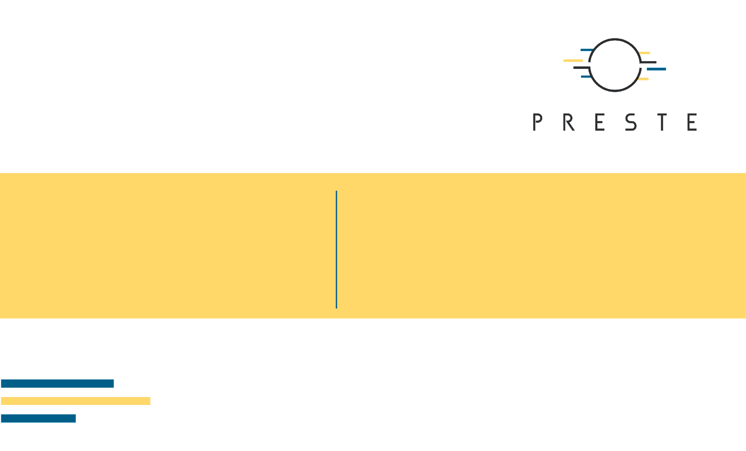
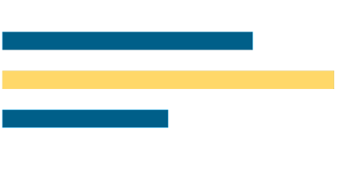
Dimensionality Reduction and Geometric Learning
PCA · t-SNE · UMAP · KNN · SVM · K-means · Hierarchical clustering

Slide 2
What's for today
• Why high-dimensional biological data change the meaning of distance.
• PCA as linear dimensionality reduction and a diagnostic tool.
• t-SNE and UMAP as nonlinear neighborhood-preserving embeddings.
• KNN and SVM: supervised learning from geometry.
• K-means and hierarchical clustering: discovering structure without labels.

Slide 3

1. Geometry in high-dimensional data
What does close mean in ML?

Slide 4
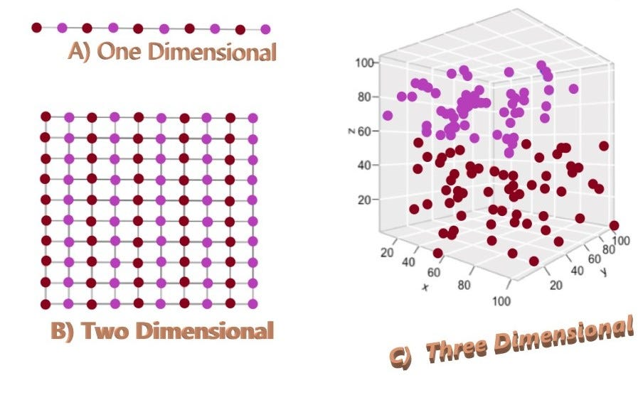
Biology often has a p>n problem or dimensionality curse
• RNA-seq - 1-1000 samples/cells * 20000-100000 genes/variants
• Metabolomics / proteomics - 10-1000 samples/cells * ~1000-2000 objects
• Molecular descriptors: 1,024-4,096 binary or ~ 250 continuous.

Slide 5
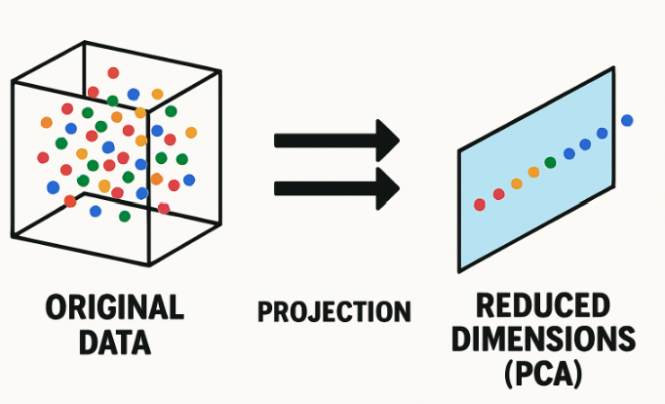
Dimensionality reduction

Slide 6
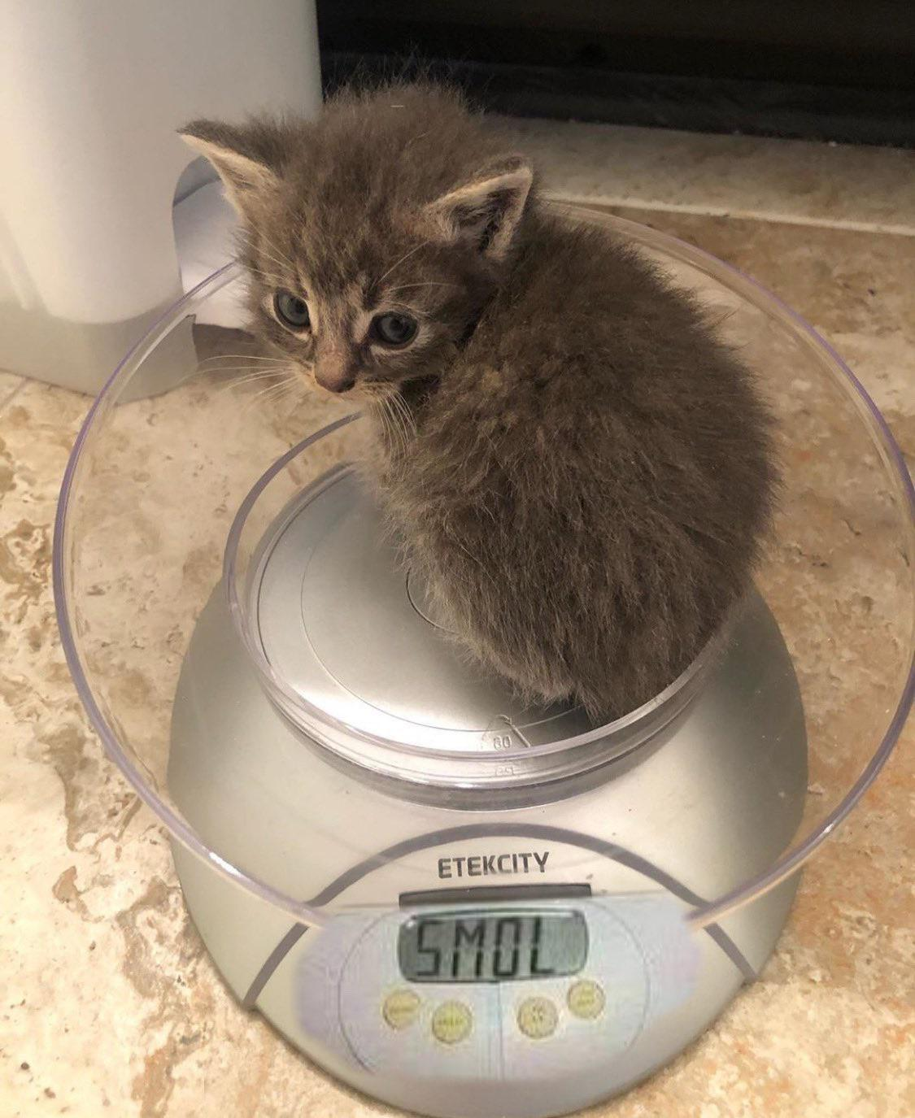
2. Dimensionality reduction
How you can compress the data.

Slide 7
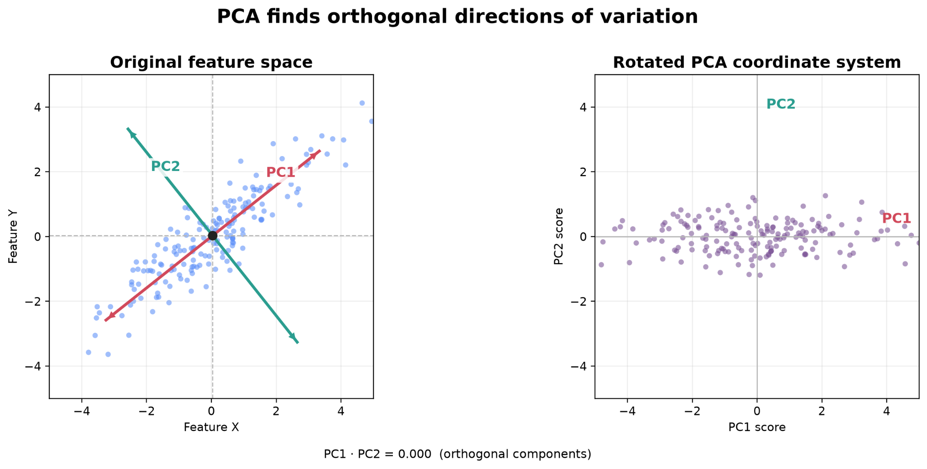
PCA constructs new axes
• PC1 is the direction containing the largest variance in the data.
• PC2 captures the largest remaining variance while being orthogonal to PC1.
• Additional components continue the same idea.

Slide 8
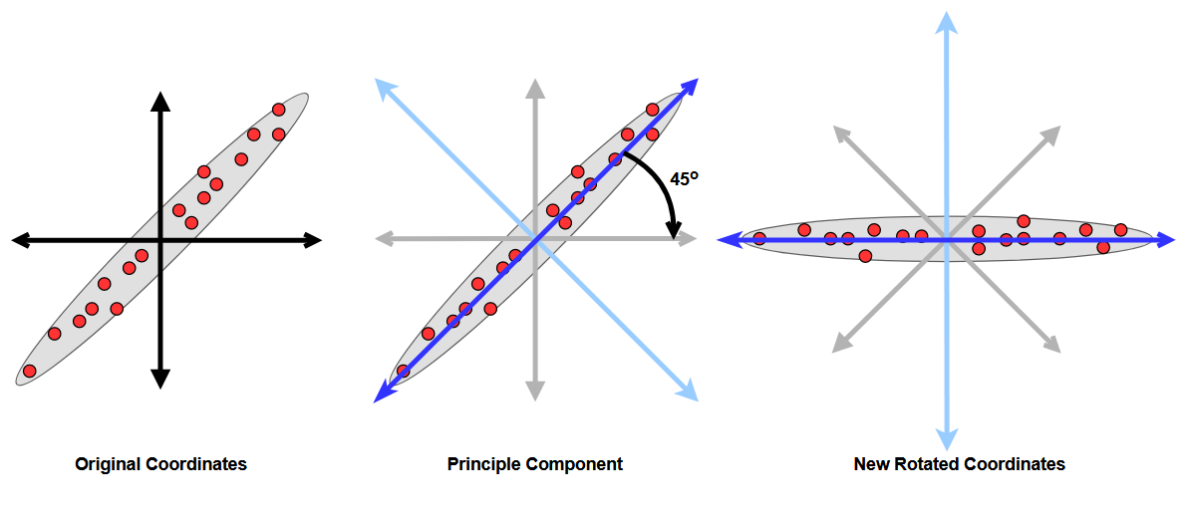
PCA intuition - rotate and then compress
• The observations do not change while coordinate system changes.
• If most variance lies along a few directions, many original dimensions become redundant.
• Keeping only the leading PCs creates a lower-dimensional representation.

Slide 9
PCA math
1. Center the data
2. Describe covariance
3. Find principal directions
Xc = X − 1μᵀ
C = 1/(n−1) · XcᵀXc
Cvₖ = λₖvₖ
Subtract each feature mean so PCA describes variation around the data centre.
C summarizes which features vary together and how much variance each contains.
vₖ = loading direction; λₖ = variance captured along that direction.
4. Project samples into PC space
Explained variance of PC k
Z = XcV
EVRₖ = λₖ / Σⱼ λⱼ
Rows of Z are sample scores in the new coordinate system.
Large eigenvalue meaning that PC captures a larger fraction of total variance.

Slide 10
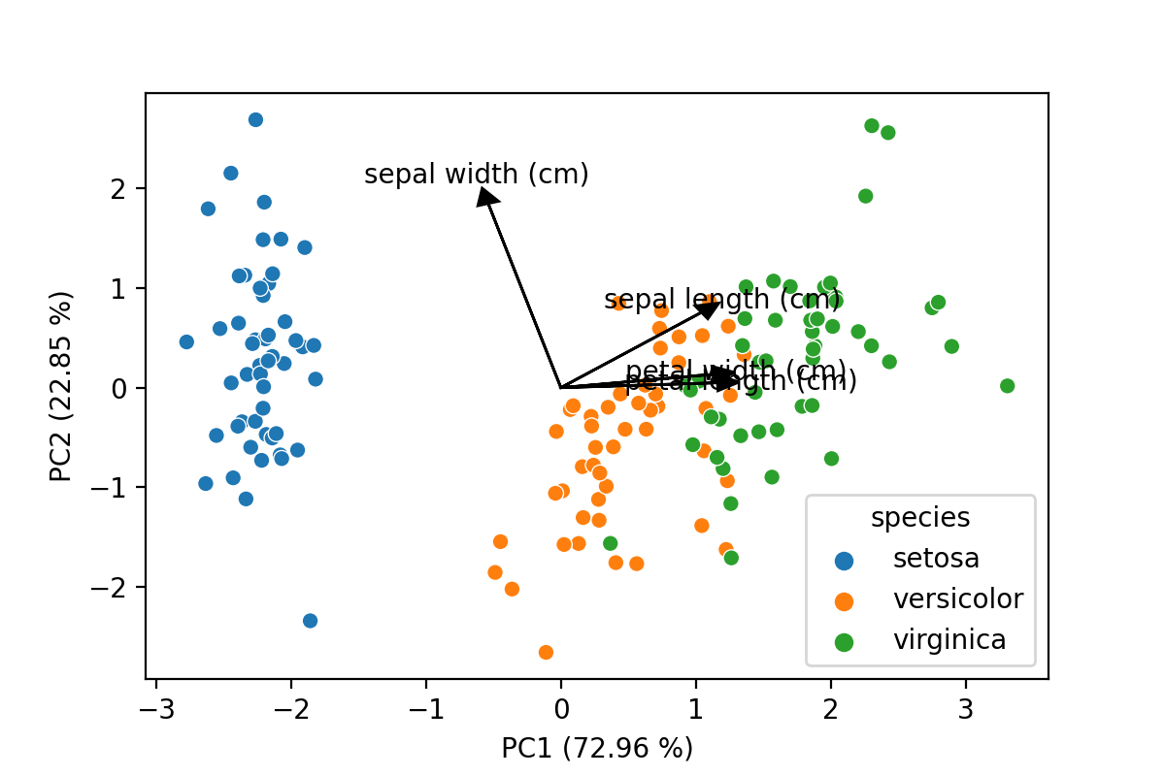
Scores, loadings and explained variance
• Scores: coordinates of samples in PC space - where are the samples?
• Loadings: contribution of original features - what defines each PC?
• Explained variance: fraction of total variance captured by each PC.
• These three outputs answer different biological questions.

Slide 11
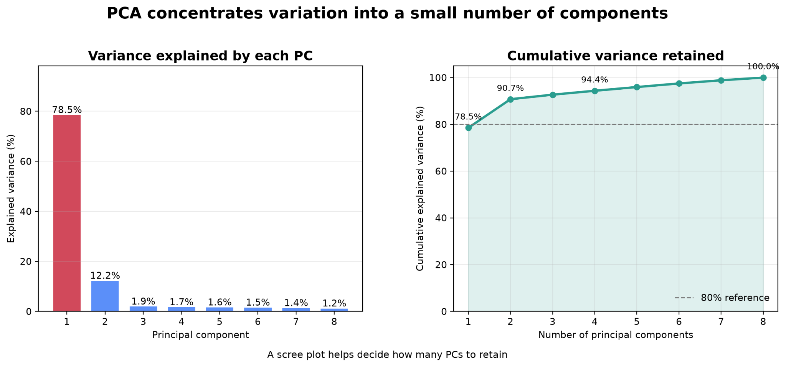
How many PCs should we keep?
• Scree plot: inspect the decline in explained variance.
• Cumulative explained variance can be useful, but 80% or 90% is not a universal rule.
• A low-variance PC can still contain biologically predictive information.
• The appropriate number of PCs depends on the downstream task.

Slide 12
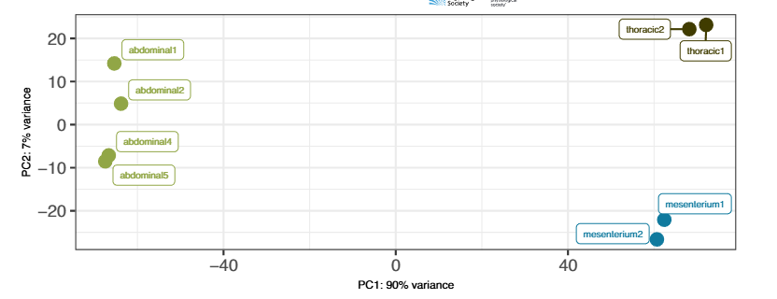
PCA as a bioinformatics diagnostic
• Color samples by treatment, tissue, sex, batch, sequencing run or donor.
• Unexpected separation can reveal batch effects or sample swaps.
• Outlying samples may indicate technical or biological anomalies.
• PCA is often one of the first plots inspected after expression normalization.

Slide 13
Should we scale before PCA?
• Centering is fundamental: PCA should generally operate around feature means.
• Unit-variance scaling is useful when features have incomparable physical units.
• For normalized expression data, scaling every gene can strongly change which genes drive PCA.
• Always connect preprocessing to the meaning of variance in the dataset.

Slide 14
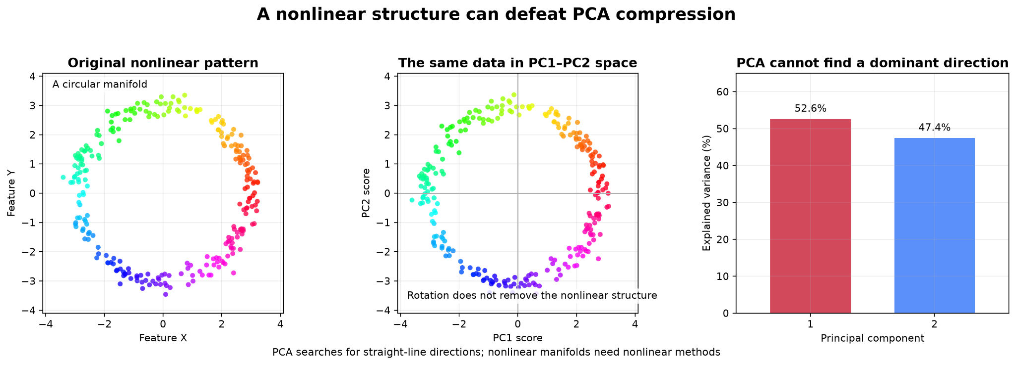
PCA is linear
• A curved low-dimensional manifold may require many linear PCs.
• PCA preserves variance globally, not local neighborhood structure specifically.
• This motivates nonlinear visualization methods such as t-SNE and UMAP.

Slide 15
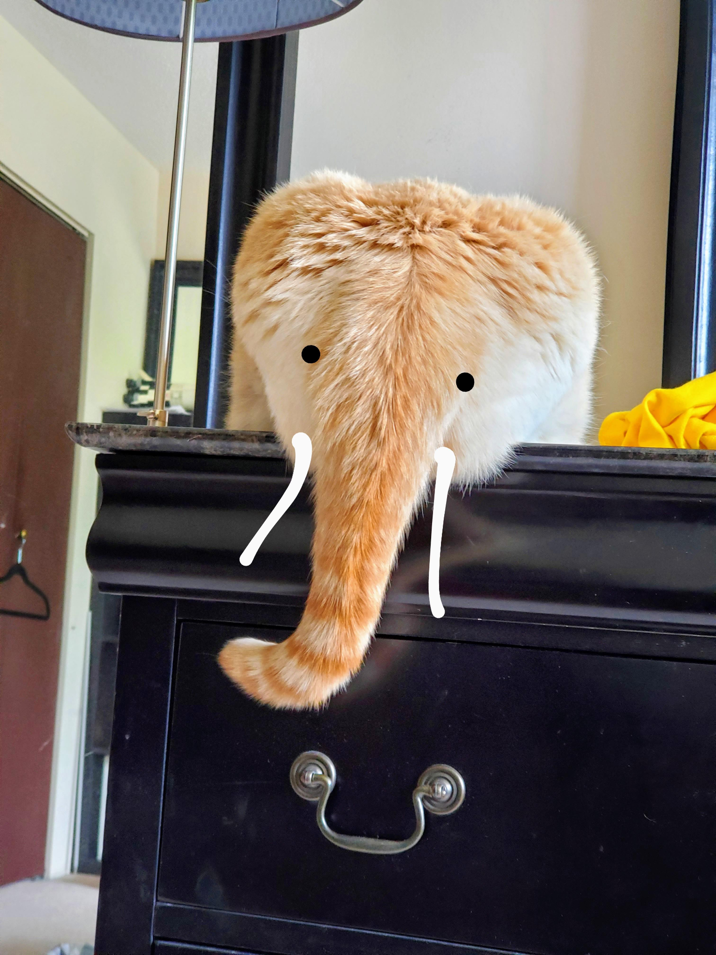
3. Advanced dimensionality reduction
Nobody really knows like they work - but they do

Slide 16
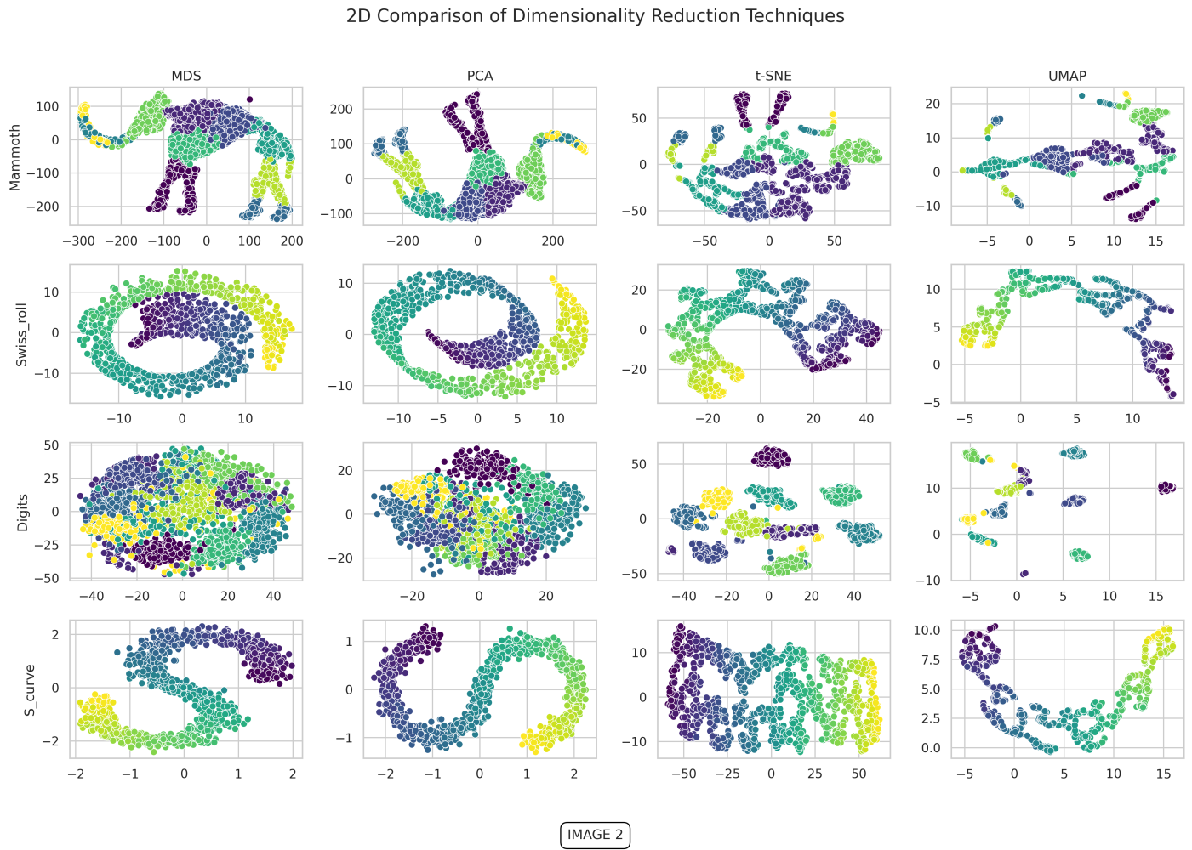
t-SNE: preserve local neighborhoods
• High-dimensional pairwise similarities are converted into probabilities.
• The 2D/3D embedding is optimized so nearby samples remain nearby.
• The objective emphasizes local structure more strongly than global geometry.
• Its primary use is visualization, not general-purpose feature compression.

Slide 17
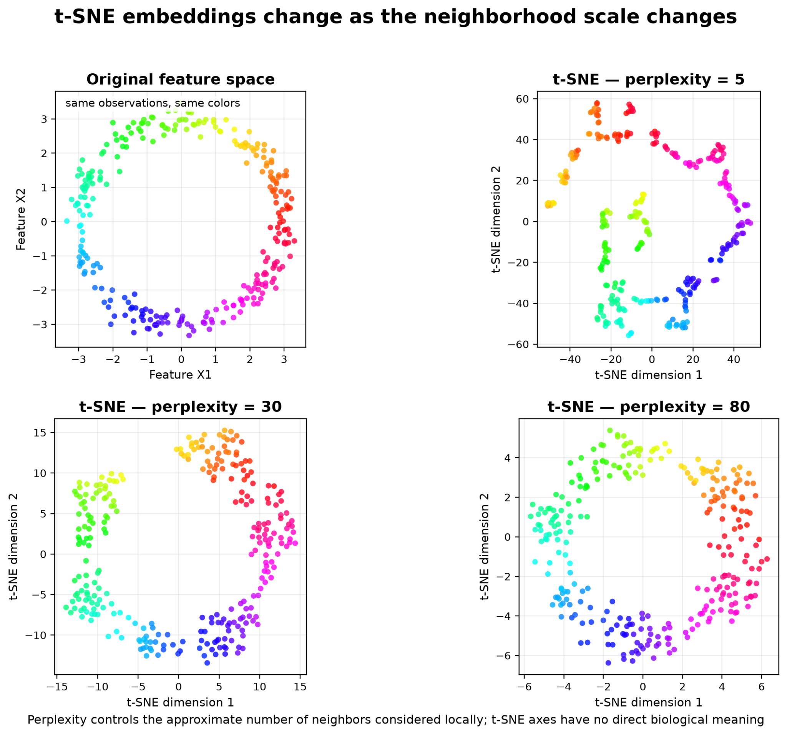
Perplexity changes the scale of t-SNE
• Low perplexity emphasizes very local neighborhoods and may fragment structure.
• Higher perplexity considers broader neighborhoods.
• Different reasonable values can produce different-looking embeddings.
• Do not choose the setting simply because it produces the prettiest separation.

Slide 18
UMAP: build a neighborhood graph
• UMAP estimates local relationships in high-dimensional space.
• It constructs a weighted neighborhood graph and embeds that graph in fewer dimensions.
• It is fast enough for many large biological datasets and is widely used in single-cell analysis.
X → k-neighbor graph → low-dimensional embedding

Slide 19
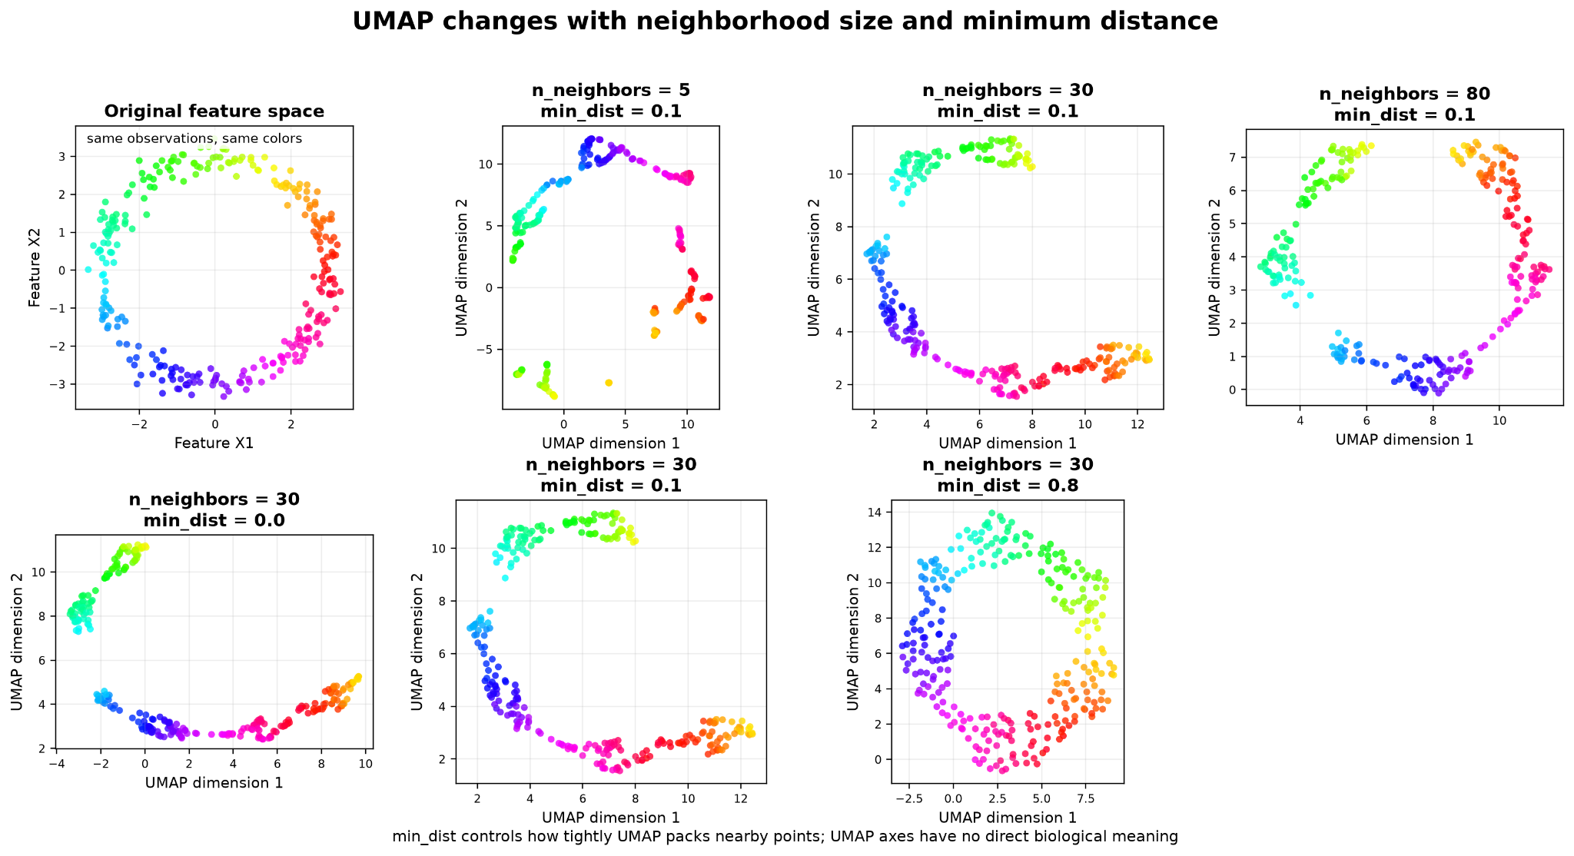
UMAP hyperparameters
• n_neighbors: local versus broader neighborhood structure.
• min_dist: how tightly observations can pack in the embedding.
• metric: what similarity means in the original feature space.

Slide 20
Typical single-cell workflow
• Normalize / transform expression.
• Select informative or highly variable genes.
• Use PCA to create a compact analytical representation.
• Construct neighbors / clusters in PC space.
• Use UMAP primarily to visualize those relationships.
expression → variable genes → PCA → neighbors/clusters → UMAP

Slide 21
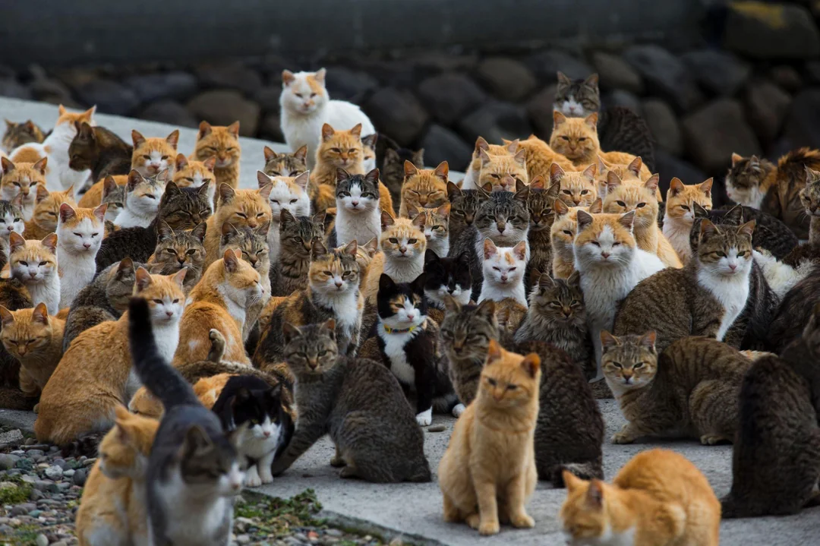
3. K-nearest neighbours
You are the sum of the 5 people closest to you

Slide 22
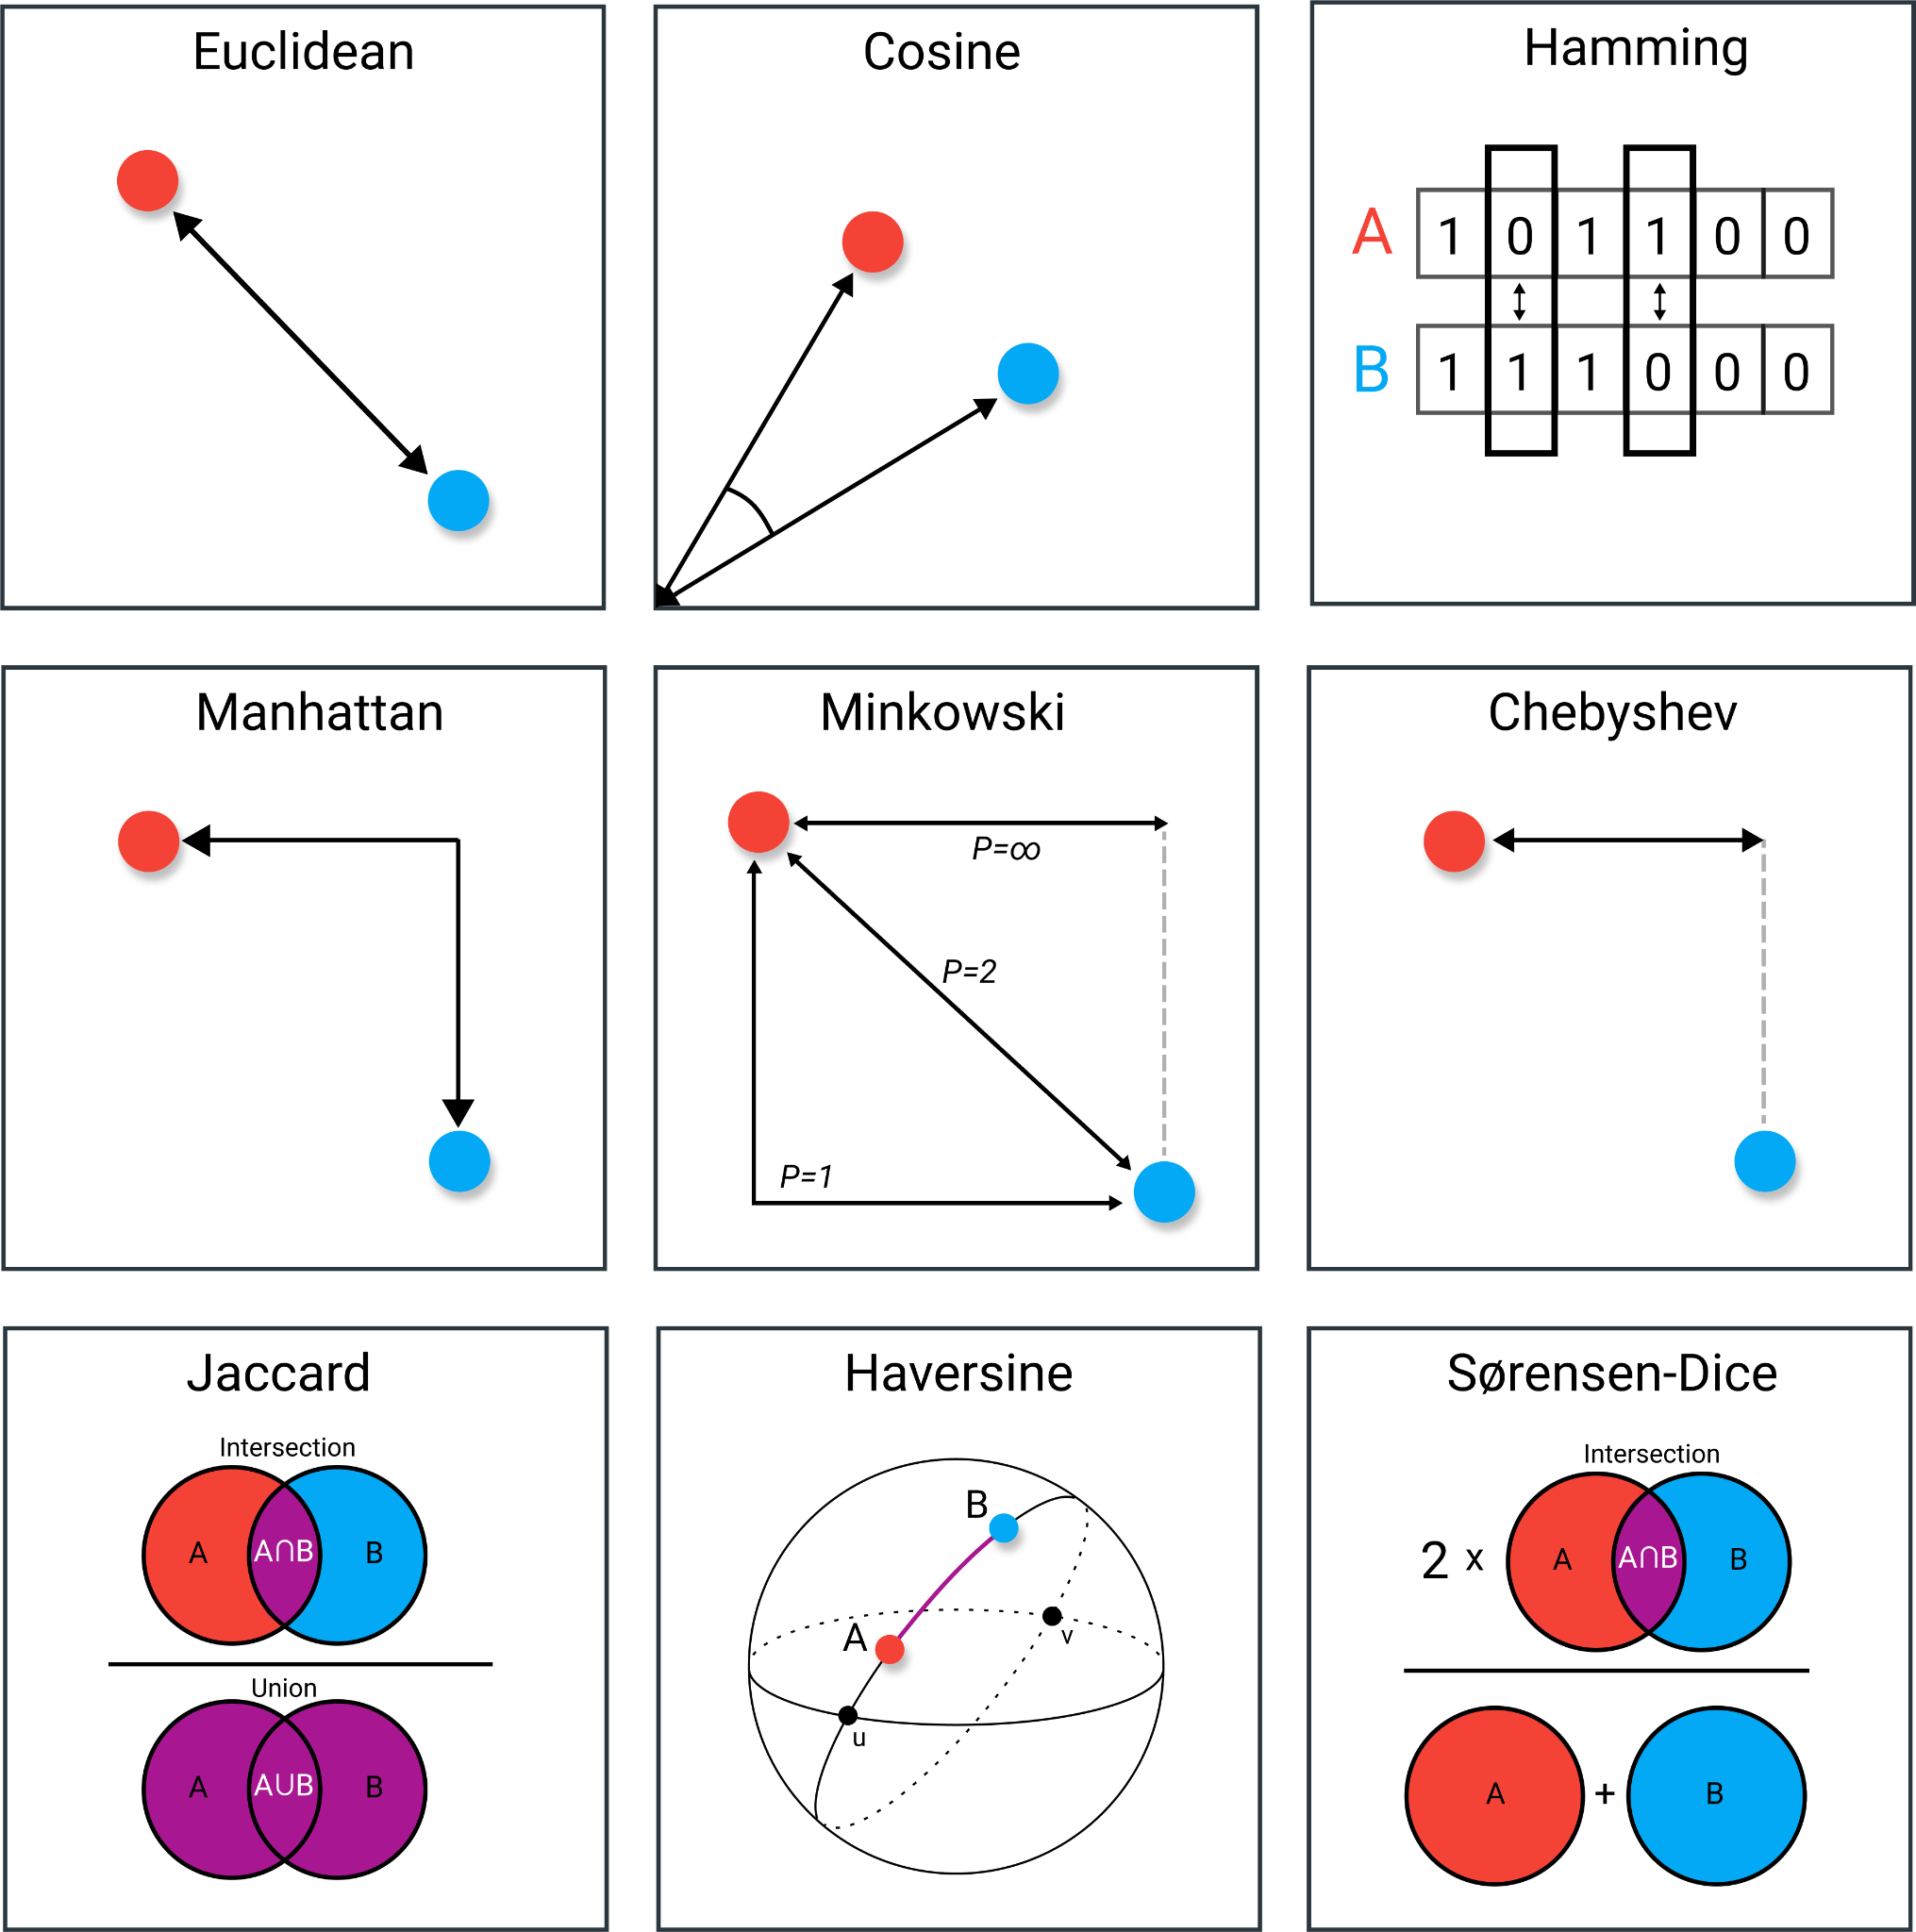
Distance is the common language

Slide 23
Why scaling matters
• Distance is sensitive to feature scale(and some other metrics too).
• A variable spanning 0-100 can dominate another spanning 0-1.
• Standardization is therefore essential for many distance-based workflows.

Slide 24
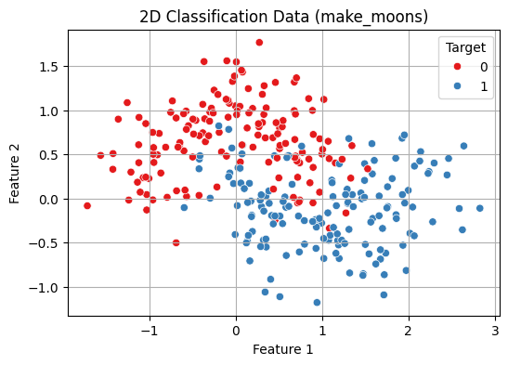
KNN
• For a new observation, calculate its distance to training samples.
• Select the k nearest observations.
• Classification: vote among their labels.
• Regression: average or distance-weight their target values.

Slide 25
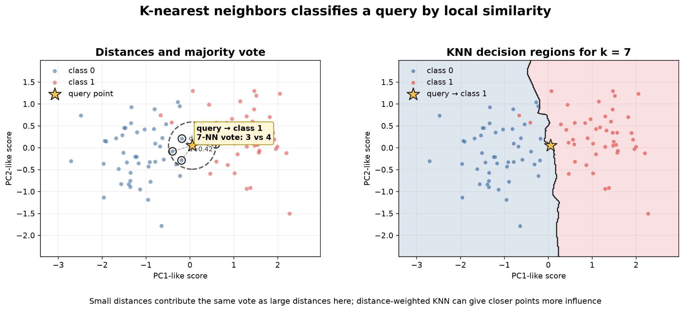
k controls model complexity
• k = 1 produces a very flexible boundary and is sensitive to noise.
• Increasing k smooths the decision boundary.
• Very large k can wash out local structure and favor majority classes.

Slide 26
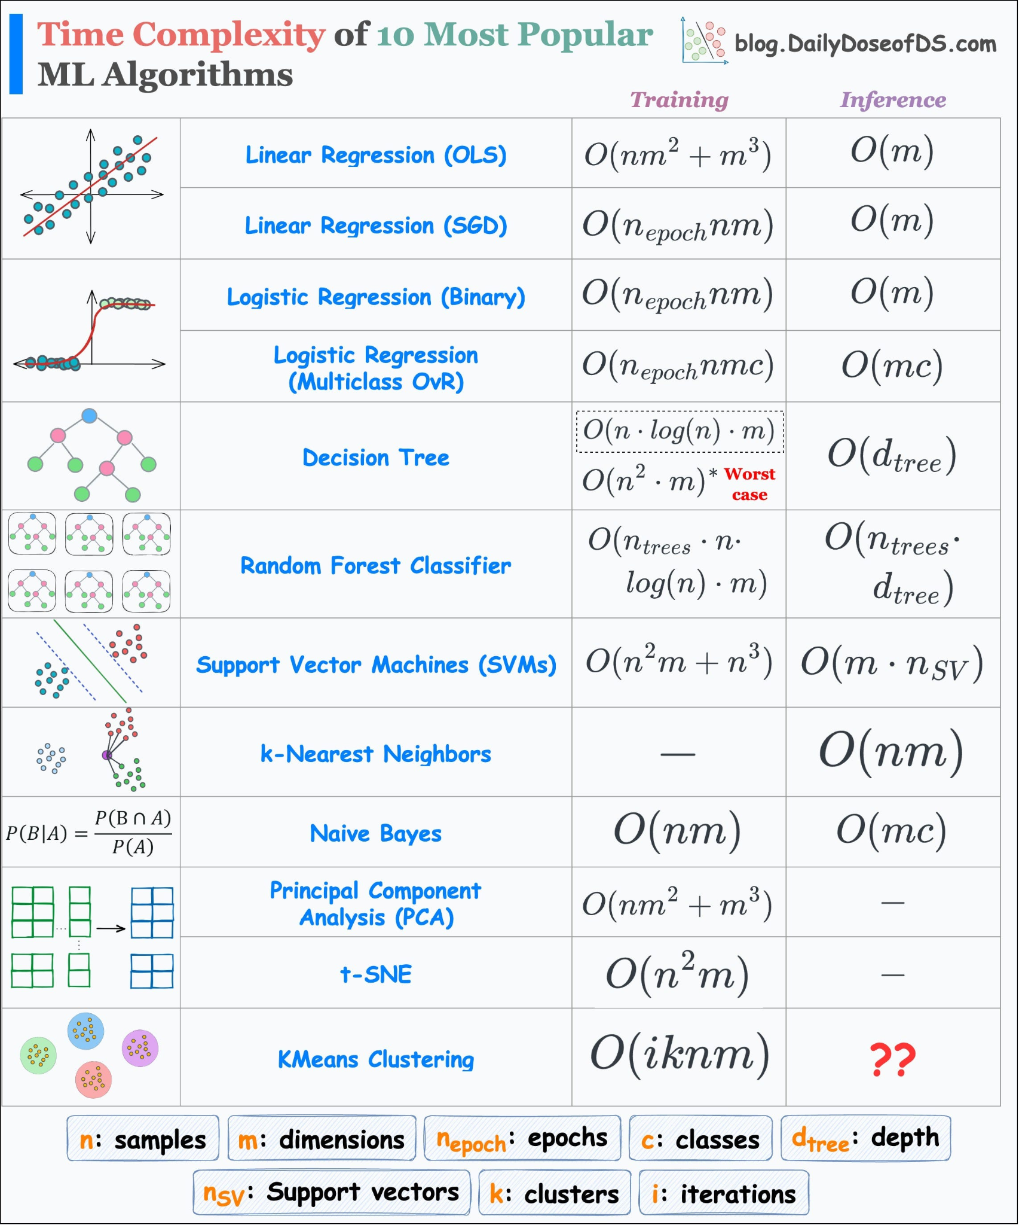
KNN training and inference

Slide 27

3. Support vector machine
How to draw a meaningful border

Slide 28
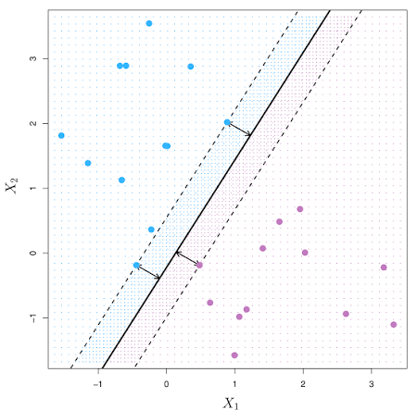
The maximum-margin idea
• Many hyperplanes may separate two classes.
• SVM chooses the boundary that maximizes the margin to the closest training observations.
• Those closest observations are the support vectors.
• Only a subset of training samples directly defines the final boundary.

Slide 29
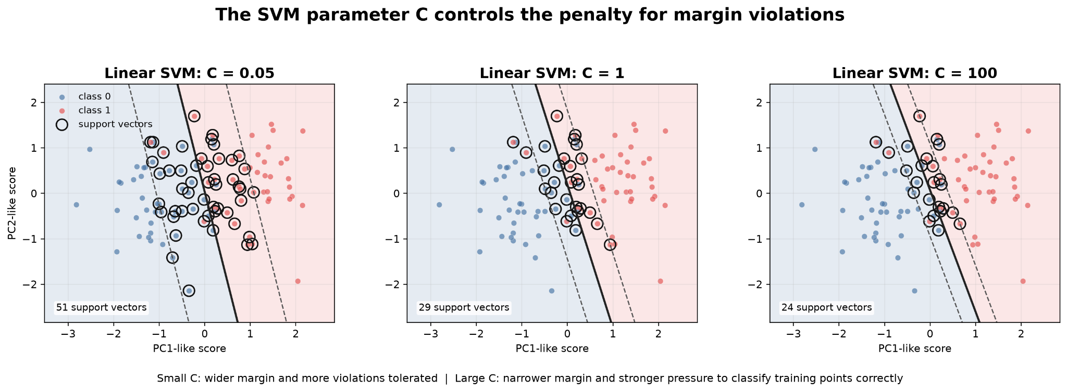
Soft margin and C
• Perfect separation is usually unrealistic for noisy biological data.
• C controls the penalty for margin violations / classification errors.
• Large C: fit training labels more strictly.
• Small C: allow more violations and favor a wider, more regularized margin.

Slide 30
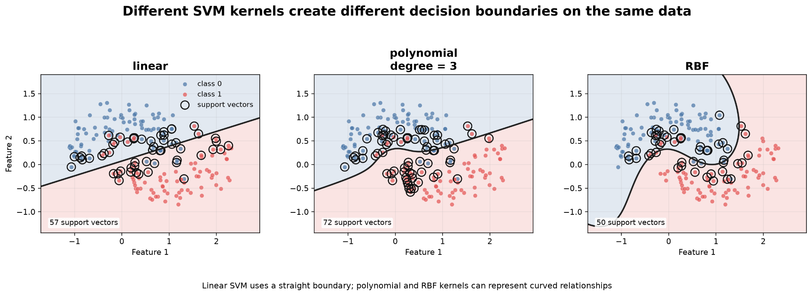
The kernel trick
• A nonlinear boundary in the original feature space may become linear in a transformed space.
• Kernel functions compute similarity without explicitly creating all transformed features.
• Common choices: linear, polynomial and radial basis function (RBF) kernels.

Slide 31
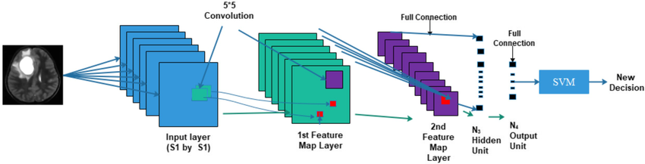
Why SVM is useful in bioinformatics

Slide 32
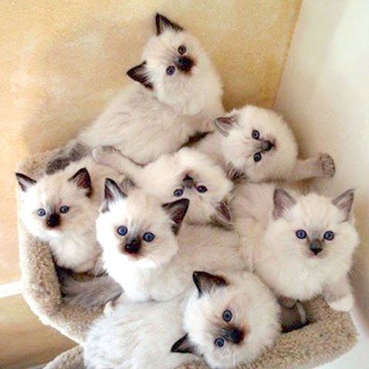
3. Clustering
I don't know anything - what can be done

Slide 33
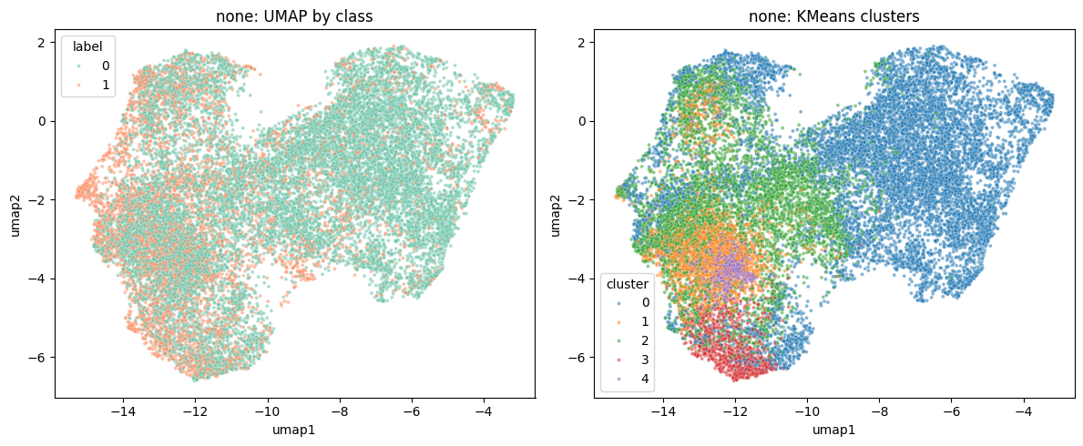
Supervised vs unsupervised geometry
• KNN / SVM: labels are known and performance can be measured against them.
• Clustering: labels are absent; the algorithm proposes structure from the feature space.
• A computational cluster is not automatically a biological population.
• External biological evidence is required for interpretation.

Slide 34
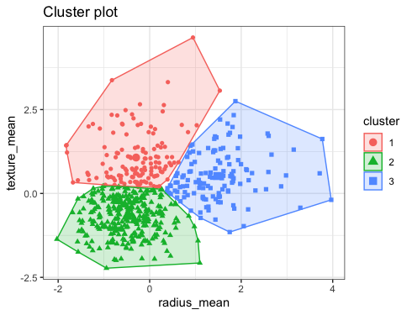
K-means
• Choose K initial centroids.
• Assign each observation to its nearest centroid.
• Update each centroid to the mean of its assigned observations.
• Repeat until assignments stabilize.

Slide 35
When K - means круто!
• Works best for compact, roughly spherical groups of similar scale.
• Explainable and tunable
• Sensitive to feature scaling and outliers.
• K must be chosen in advance.

Slide 36
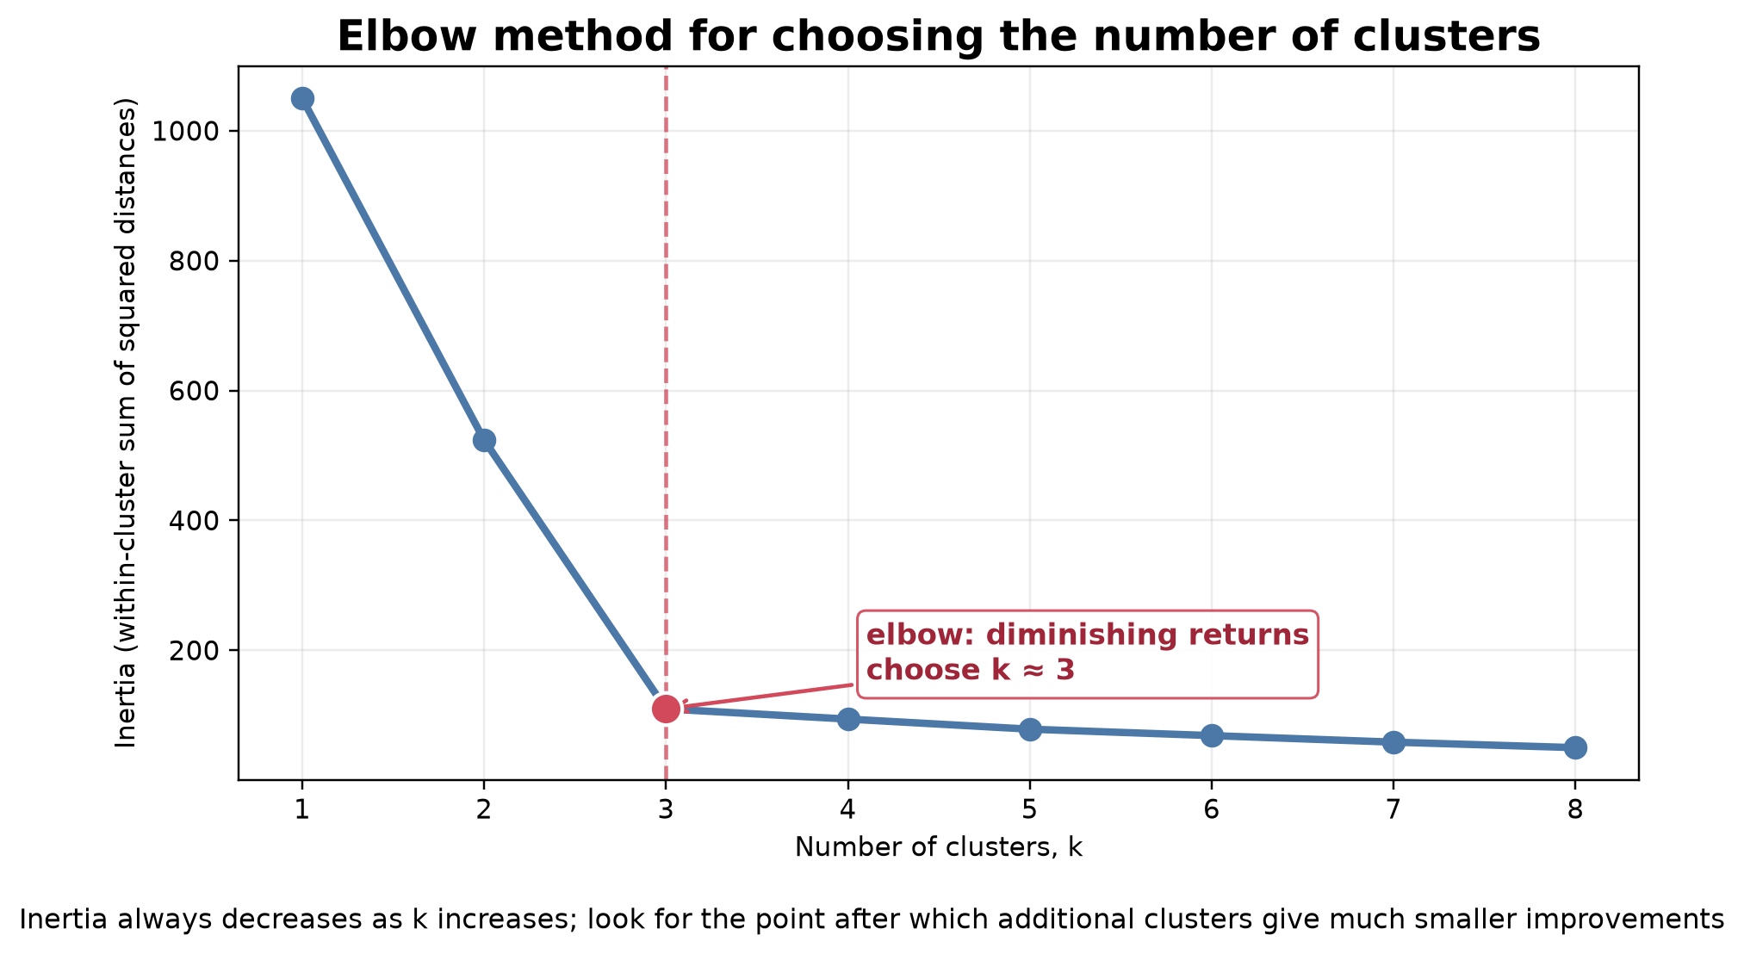
How many clusters?
• Inertia / elbow: does increasing K stop providing large reductions in within-cluster variation?
• Silhouette: are samples closer to their own cluster than to neighboring clusters?
• Stability: do clusters persist across resampling or reasonable preprocessing choices?
• Biological validation: do groups correspond to markers, phenotypes or mechanisms?

Slide 37
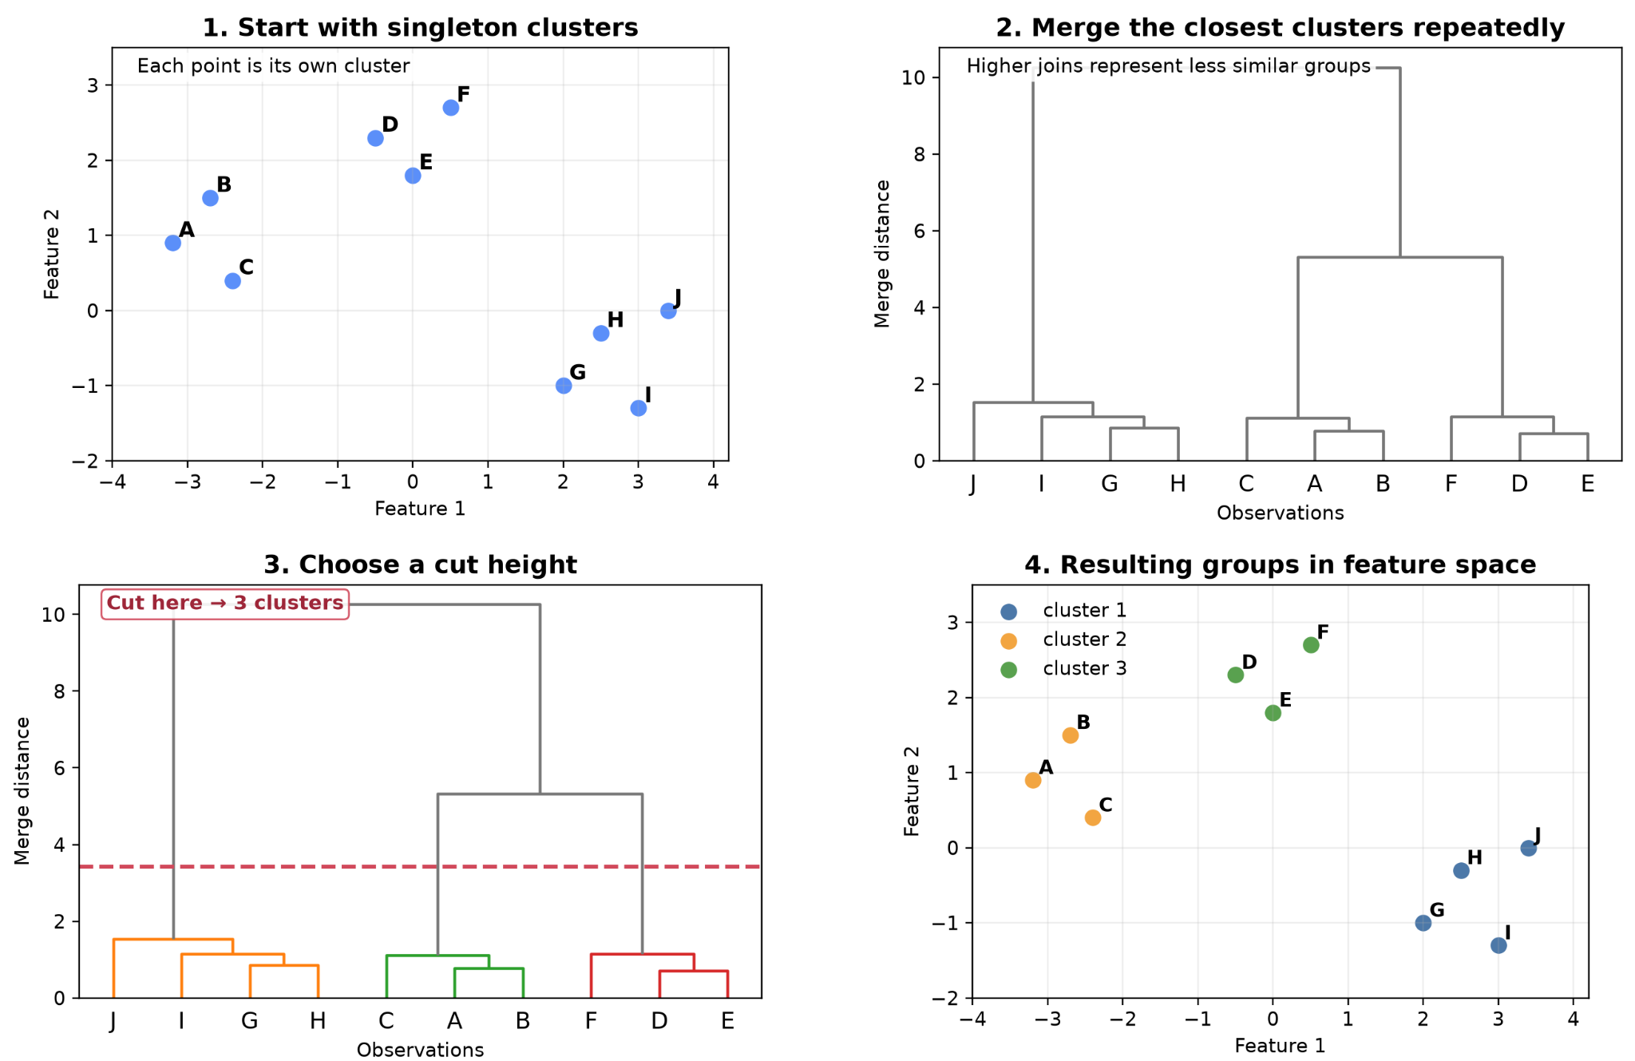
Hierarchical clustering
• Start with a distance matrix between observations.
• Repeatedly merge observations or clusters according to a linkage rule.
• The result is a dendrogram rather than one fixed K.
• Common linkage choices include single, complete, average and Ward.

Slide 38
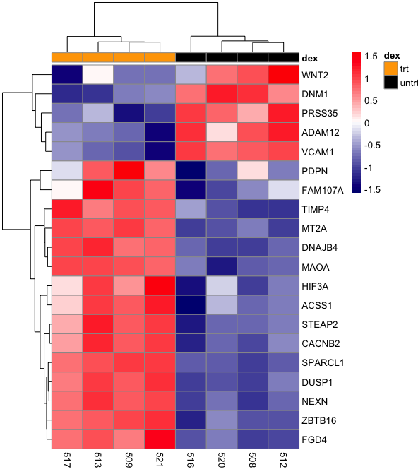
hierarchical clustering is common in biology
• Expression heatmaps naturally combine sample and gene clustering.
• Gene clusters can reveal co-expression programs.
• Sample clusters can expose tissue, phenotype or batch structure.
• Distance metric, scaling and linkage can substantially change the dendrogram.

Slide 39
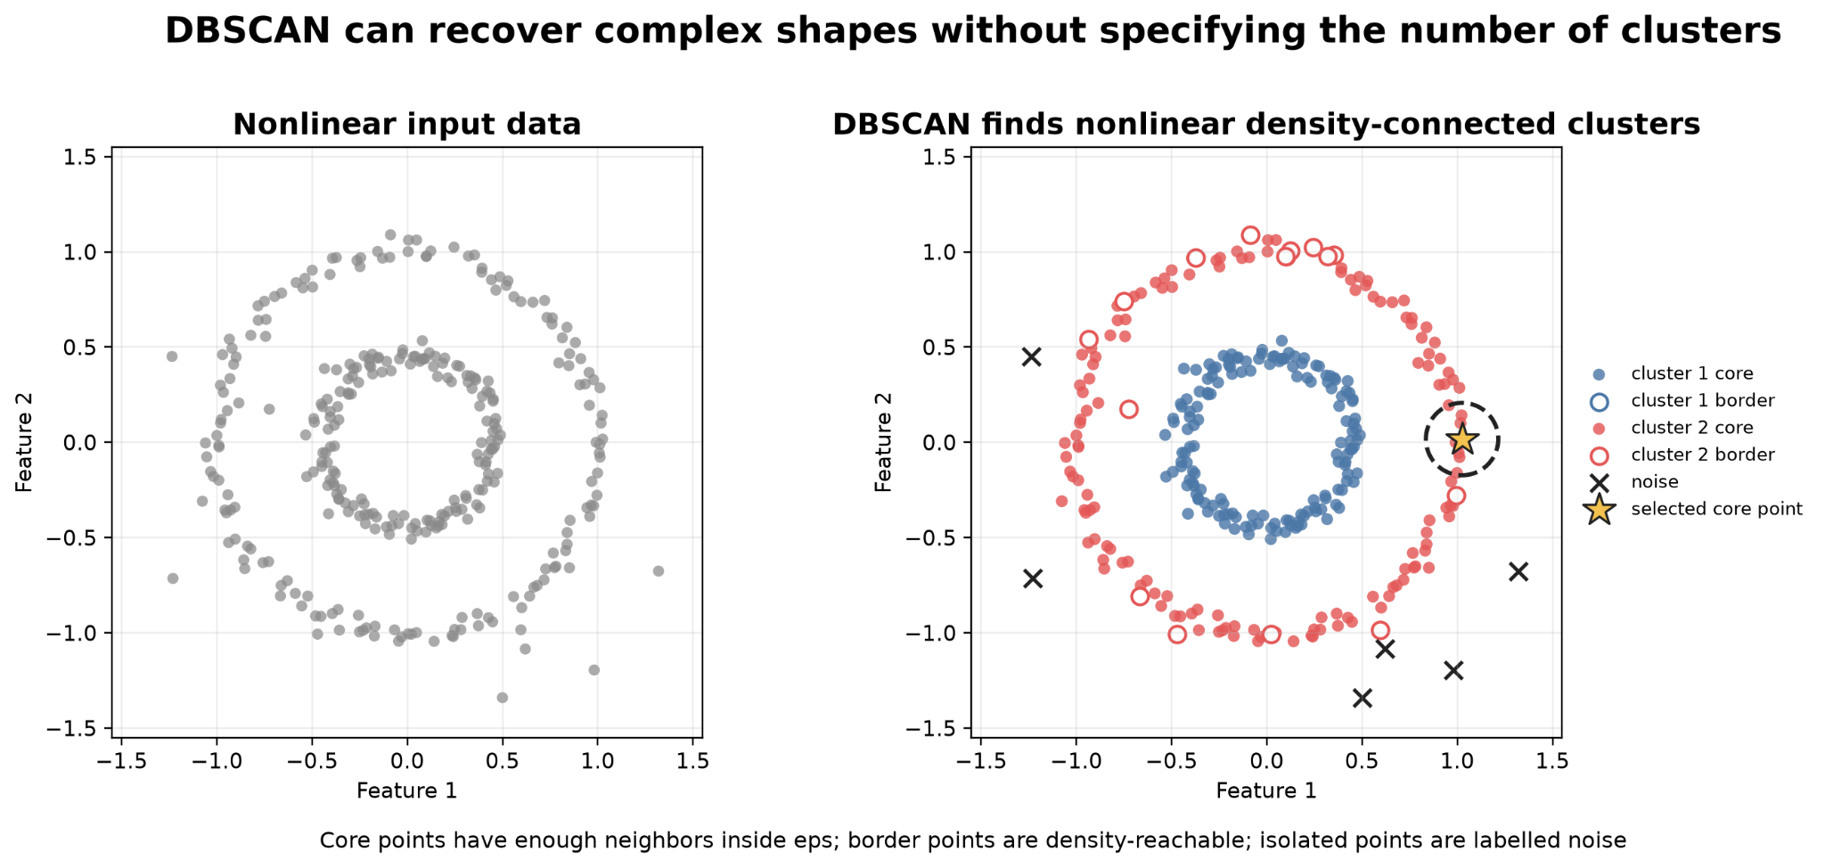
DBSCAN
• Defines clusters as dense regions separated by sparse regions.
• Can identify irregularly shaped groups and label isolated observations as noise.
• Does not require K directly.
• Requires density parameters such as ε and min_samples and struggles with strongly varying densities.

Slide 40
Practical 4
• Start from a high-dimensional RNA expression matrix and sample metadata.
• Use PCA to inspect variance, batch effects and phenotype structure.
• Compare t-SNE and UMAP and compare them with PCA on messy microscopic data.
• Train KNN and SVM to predict a known biological label.
• Run K-means and hierarchical clustering without using the labels.
• Compare discovered structure with known biology only after clustering.

